Slide 1
PRE-COVID (2019) SOFIA REAL ESTATE MARKET CONDITIONS ANALYSIS
Riste Petrov

Slide 2
Motivation
Why do research in real estate market conditions?
- Investment concentration, most people’s most important financial investment decision of their life.
- Potential real estate bubble, not just in Bulgaria or the region but worldwide phenomena.
- Previous database (dated at 2004)’s fault of using different metodology of locations and their influence.

Slide 3
STAGES OF THE ANALISYS
DATA OBSERVATION
By observing the available dataset, I will set possible hypotheses.
DATA MANAGEMENT
Setting the data into the desired formats to achieve the most effective analysis.
REGRESSION MODELS
To test the hypothesis about the real estate market.
INTREPETING THE RESULTS
RESULTS BASED INSIGHTS
Interpretation of the results and testing of the hypothesis.
Using insights to help stakeholders make better decisions

Slide 4
Data Analysis
Variables Legend: (Name – operation – desctiption) * - modifed, X – excluded, T – transformation , D – dummy, N – none
Type – *, D - type of property
Regiid – X – region of the property
Townid – X – town of the property
Quartid - *, T – the neighborhood of the property
Price (Euro) – T (ln) – the advertised price for the property
Euro/sq.m. – t (ln) – the price per sq. meter
Area – T (mean,med per neig.) – area/size of the property
Constr. - *, D - type of construction of the property
Year – t (mean med per neig.) – construction year
Floor – N – floor of the property
TEC - * - central heating variable (ДА/НЕ) – transformed to 1/0
Published or Renewed & Valid date – * – a made a operational variable from both of them named Listing days.
Seller – D – Either Agency or Individual (personal_seller)
P.S If there was data if the appartment had furniture and was renovation would have helped with the models specification.

Slide 5
Feature Engineering
The following data management was made:
Studio, Big Property & Story of a House were introduced to the type variable.
Various transformation made to Quartid explained in the next slide.
Brick, EPK, Pannel dummies were introudced.
Old dummy was set if the year of construction was after 2004.
Listing time was created but had limited usage in models, which could be based on the limitations of the messurment method, not the inherent meaning of it.

Slide 6
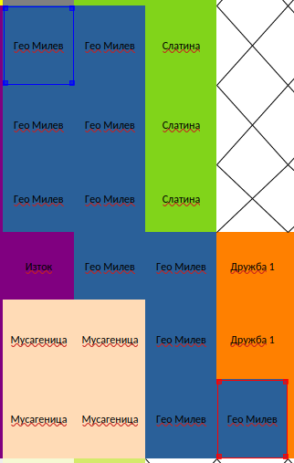
Quartid dummies - calculation
A prop map of Sofia’s neighborhoods was done in Excel.
Each square is 500m x 500m
Using the map, each neighborhood’s central point was calculated and set to be the NS = [-9,9] and WE = [-9,9] cordinate.
Distance from Center = √(NS² + WE²)
When compiling the map each neighborhood was asigned if it had metro access or not.
NS formula for Geo Milev
=-(ROUND((ROW($MAP.AA25)
+ ROW($MAP.AD30)) / 2, 1) - 21) / 2
WE formula for Geo Milev
=(ROUND((COLUMN($MAP.AA25) +
COLUMN($MAP.AD30)) / 2, 1) - 19) / 2
A prop map of Sofia’s neighborhoods was done in Excel.
Each square is 500m x 500m
Using the map, each neighborhood’s central point was calculated and set to be the NS = [-9,9] and WE = [-9,9] cordinate.
Using the Pythagorean theorem, the aerial distance from the center was calculated.
Distance from Center = √(NS² + WE²)
When compiling the map each neighborhood was asigned if it had metro access or not.
NS formula for Geo Milev
=-(ROUND((ROW($MAP.AA25)
+ ROW($MAP.AD30)) / 2, 1) - 21) / 2
WE formula for Geo Milev
=(ROUND((COLUMN($MAP.AA25) +
COLUMN($MAP.AD30)) / 2, 1) - 19) / 2

Slide 7
Quartid Feature Engineering
LUX – Luxurious Location
PARK – attractive parks within walkable distance (500 – 1000 meters)
- Boris Garden, South, Western Park
MALL – shopping mall within walkable distance.
- Park Center, Bulgaria Mall
- Western Mall, Mall of Sofia
- Serdika Mall, The Mall, Ring Mall
- KIDS – number of kids in all kindergartens in the neighborhood
- GARTEN (mean & median near 2) – number of kindergartens in the neighborhood
- KG_RATIO – density of children per number of kin dergartens in the neighborhood
- KG (70% is 1) – logical value if there is a kindergarten in the neighborhood. Kindergarten data:

Slide 8
Regression Analysis
Over / Under priced logit
Using Over/Under priced variables to
stimulate a real estate profetional.
OLS Regression
Predicting ln(price) using exogenus regressors.
Structural model
Predicting ln(price) using
layman-accessible regressors.

Slide 9
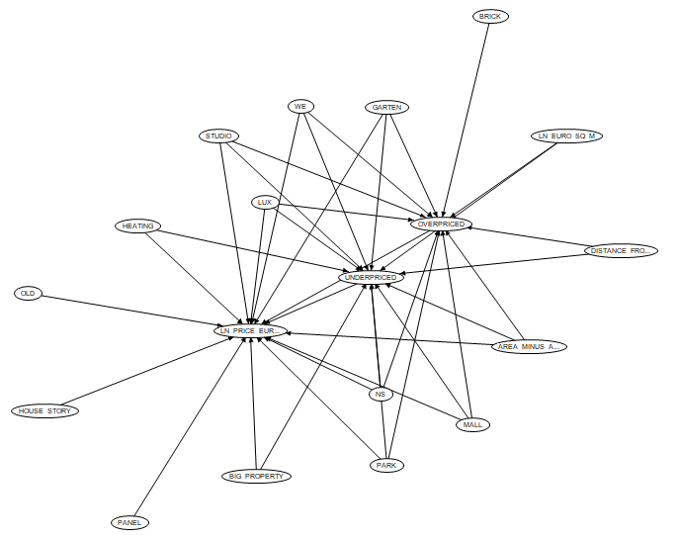
Structural Model

Slide 10
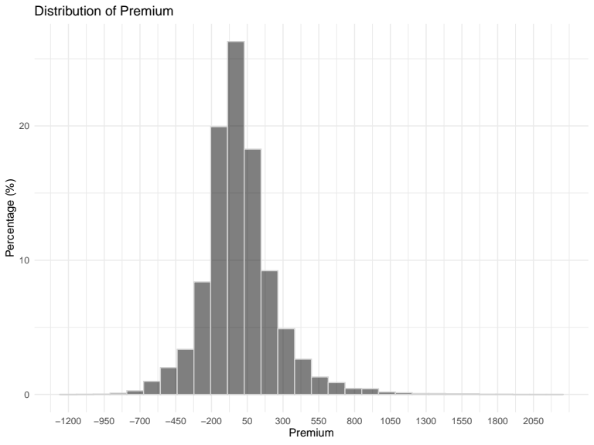
Under & Overpriced Definitions & Logit
When predicting them as real estate proffessional (without any moral hazard) would have done it was considerd maximazation of Specifiaction (99%) or minimazation of FPR (1%)
OVERPRICED – half standard deviation (127.10 EUR) over the median price of the square per meter in the neighborhood in which the property is located in. ( around 22% of properties)
FAIRLY PRICED – around 50% of the properties
UNDERPRICED – half standard deviation (127.10 EUR) under the median price of the square per meter in the neighborhood in which the property is located in. ( around 26% of properties)
 | MCFADDEN R2 | AUC | Better than coinflip | MAX ACCURACY | ACCURACY AT FPR 1% | TRADEOFF at FPR 1% | CUT OFF probability for FPR 1%
OVERPRICED | 0.6142 | 0.4457 | 5.43% | 91.15% | 88.92% | -2.24% | 0.80
UNDERPRICED | 0.5367 | 0.5747 | 7.47% | 89.79% | 88.43% | -1.36% | 0.71

Slide 11
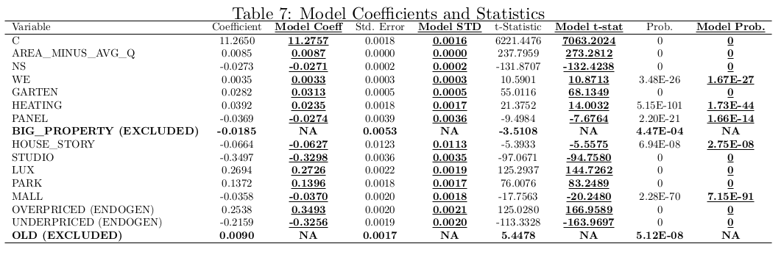
OLS regression versus Structure Model

Slide 12
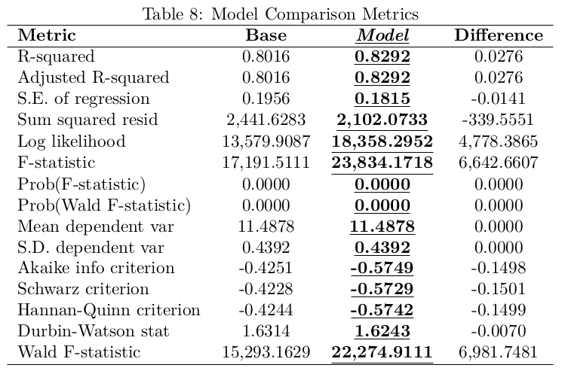
OLS regression versus Structure Model
Nominal Example – Model versus actual value
A baseline flat caluclated by the model in the city center with an avarage area of 93.7 meters squared is priced around 130,119.81EUR. (without heating) or 131,636.55 EUR (with heating)
Which is underestimated within 5.5% and 4.5% of the median euro price per square meter for an avreage aread flat of 93.7 meters.

Slide 13
Limitations
Measurement – all the mesurments are based on the neighborhood which are inaccurate and assume that the used sample has a neutralization effect of intra neighborhood distribution of the observations
Multicolinearity – Pottential problem with the prediction wheter the property is over/under property using the natural log of price per square meter. (Not crutial problem as it has different distribution of the premium, see apendix)
Heteroscedacticity – is present and HC standard errors were used as a remedy.
Misspecification – all regression fail the Ramsey Reset test implying that the models are theoreticly misspesified.
Adymanic model – the model is a based on the snapshot of 2019, no panel data analysis to see the effects trough time and potentaly in the future.

Slide 14
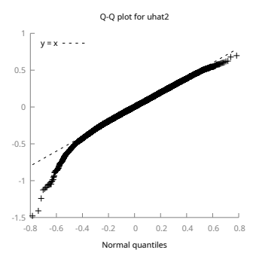
Residual QQ Plot
Normality of residuals is not present.

Slide 15
Quick Summary
Location
Location of the properties is influenced aproximetly by
-3% for every 1km - North off the Center
Luxurious Location adds about 27%
A shopping center in the neighborhood reduces the price by around -3%
Property Classification
Panel type properties have a discount of around -3%
House stories have a discount of around -6%
Studios tend to have a discount of -32%
Cental Heating, Park & Kindergarten
Central Heating increases the price by around 2%
Attractive park increases the price by around 13%
Each kindergarten in the neighborhood increases the price by around 3%

Slide 16
— Baron Harold Samuel , founder of Land Securities (UK)
Thank you for your attention
Q&A
“Real estate is all about location, location, location.”

Slide 17
APENDIX
APENDIX

Slide 18
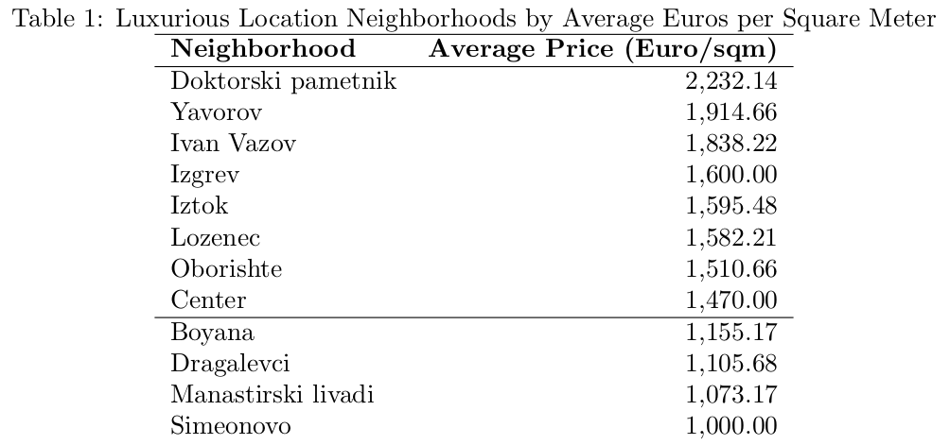
Luxurious Location

Slide 19
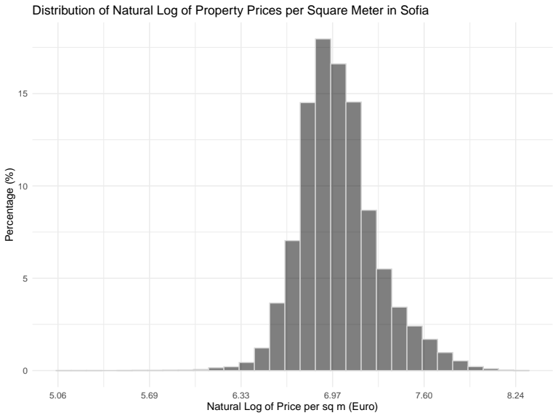
Premium & Price per Square Meter Minus Median of the neighborhood distributions
Premium & Price per Square Meter Minus Median of the neighborhood distributions

Slide 20
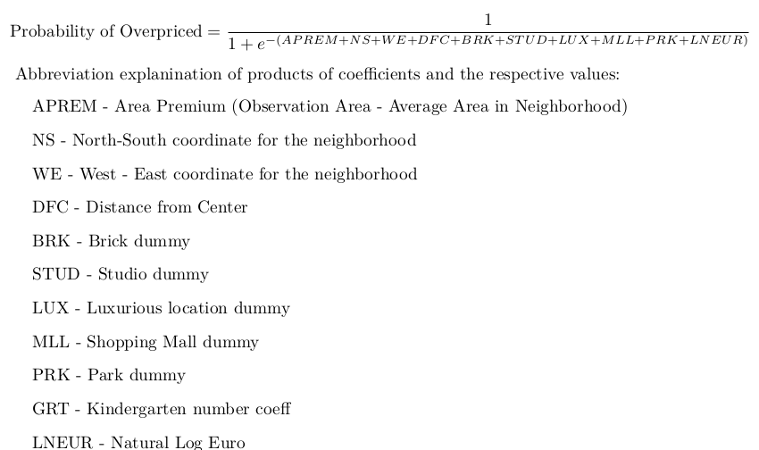
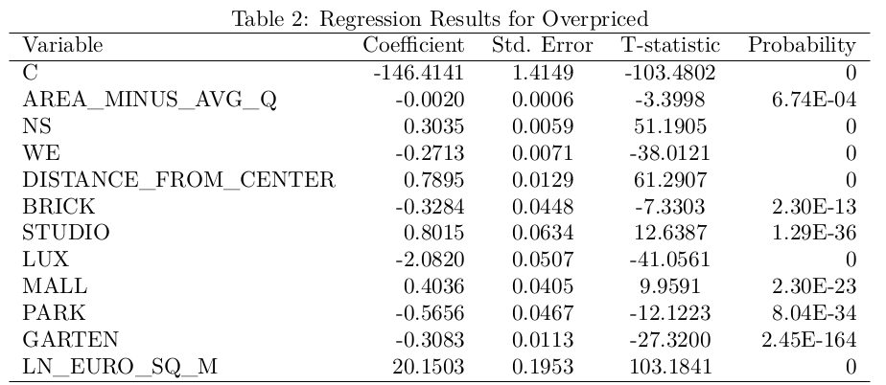
Overpriced formula and regression output

Slide 21
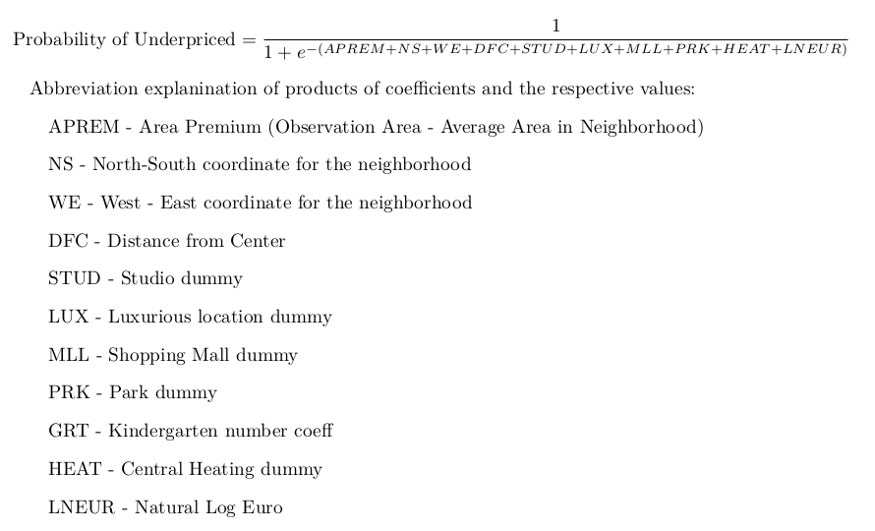
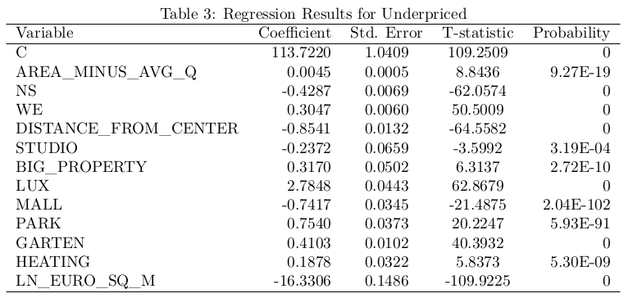
Underpriced formula and regression output

Slide 22
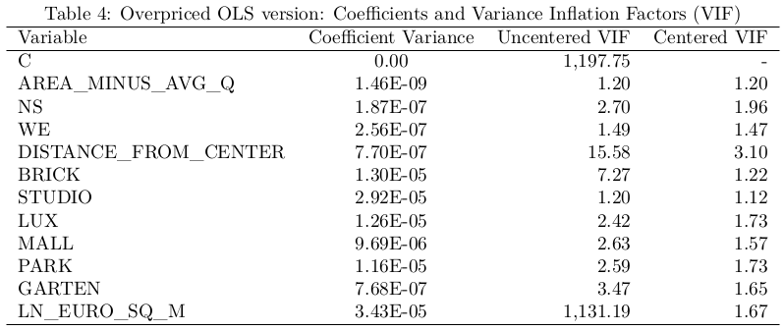
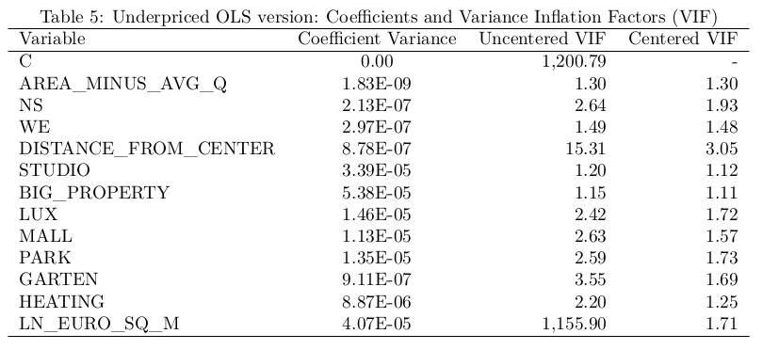
LOGIT - OLS Same Specification VIFs

Slide 23
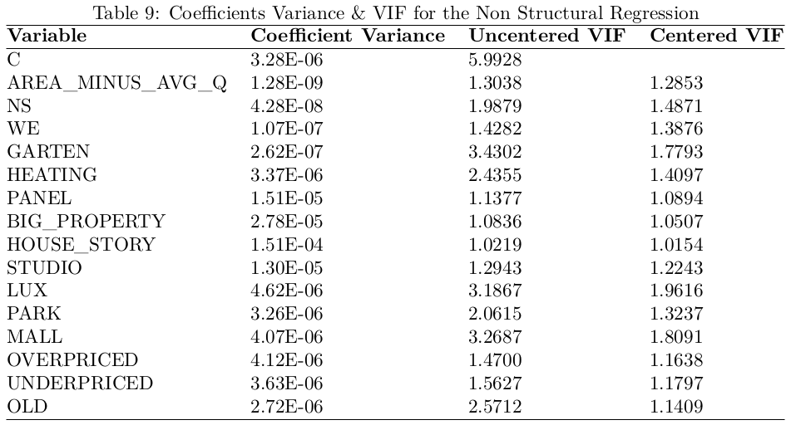
OLS Regression VIF

Slide 24
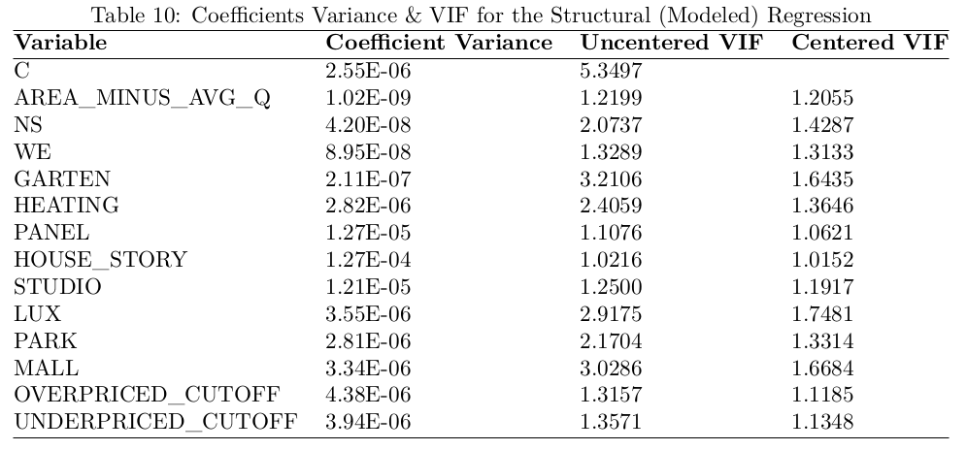
Structural Model VIF

